Slide 1
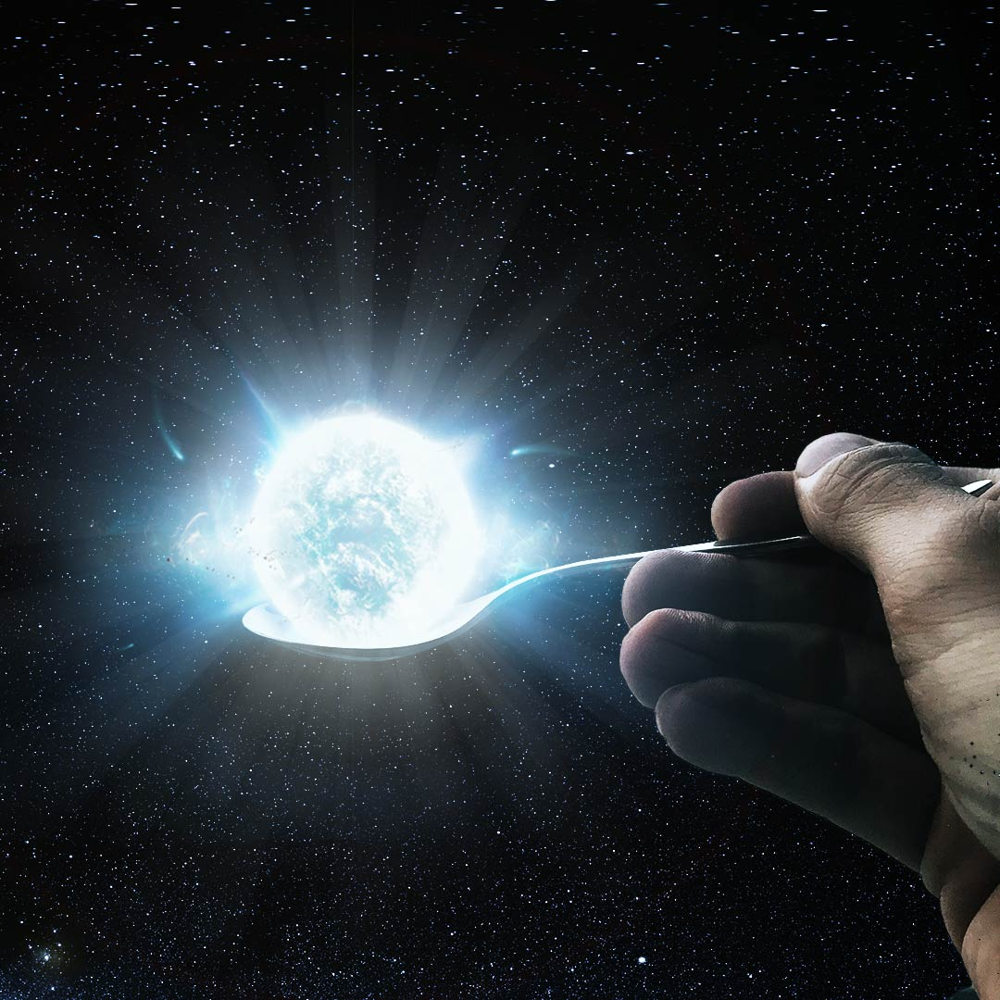
NEUTRON STARS
Solving structure equations for a neutron star both in the Newtonian and the GR case
Luca Bianchi, December 2021

Slide 2


STRUCTURE EQUATIONS
two kind of forces keeping the equilibrium for the star: the particles pressure and the gravitational pull.
Using Newtonian gravitational equation
Using GR equations we have relativistic corrections
Conditions:

Slide 3





PURE NEUTRON STARS
The quantities needed for the equation of state are obtained using Fermi-Dirac statistics in a relativistic pure neutron gas
Non relativistic approximation:

Slide 4





INCLUDING THE INTERACTIONS
Main idea: split the neutron star into two sections, the crust and the core.
Each section is described by a piecewise polytropical equation, i.e. each portion of the section is described by a particular polytrope and then we join the equations using continuity conditions
First principle of thermo. Integrated leaves a constant a to be fixed
Condition on the last layer of the crust
Conditions between different layers

Slide 5





RUNGE-KUTTA METHODS
Main idea: more step to get a better value for the slope
Expand around the center of the interval
Euler method for the intermediate step

Slide 6


RK4
For the Newton and TOV equations a RK4 method is used

Slide 7

CUBIC SPLINE
The spline function S has to be a C2 function, should fit the datas and we choose it to be made of degree 3 polynomials. So the conditions:
Endpoints condition:

Slide 8

CUBIC SPLINE
Work with second derivatives to have linearity in x
Lagrangian interpolation
Integrate twice and fix the constants with the previous conditions:
h = interval

Slide 9

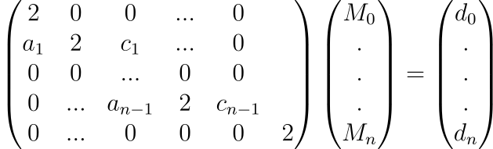







CUBIC SPLINE
Thus the system is
Thomas prescriptions to solve the system

Slide 10
INTUITIVE SCHEME FOR THE CALCULATION:
1) In each main, define a chosen state picking out an equation of state from eqs_state and a cv. Build a star using the class Neutron Star from Nsclass.
2) The solutions (Newton or TOV) can be casted through the star_solver method of the star, which should be fed with another star’s method for the eq type (Newton_eqs or TOV_eqs) and a cv.
3) star_solver calls ODE_solver in calculemus which eats the eq type and the cv. ODE_solver has the initial values of the problem and builds the array of solutions, by calling another function, RungeKutta, which furnish the advanced new value for the solutions, and by appending the sum of these values until the pressure is zero.
4) To evaluate each new value, RungeKutta needs the eq type and the values of the quantities.
SOME REMARKS:
1) For the initial conditions, we cannot use r=0 so the first value of the radius was set to be equal to an arbitrary small value csi.
2) The most convenient choice for the units, in terms of numerical errors, in the calculations was the geometric ones, i.e. G=c=1. A convertion dictionary was used to go from cgs to geometric and viceversa.

Slide 11
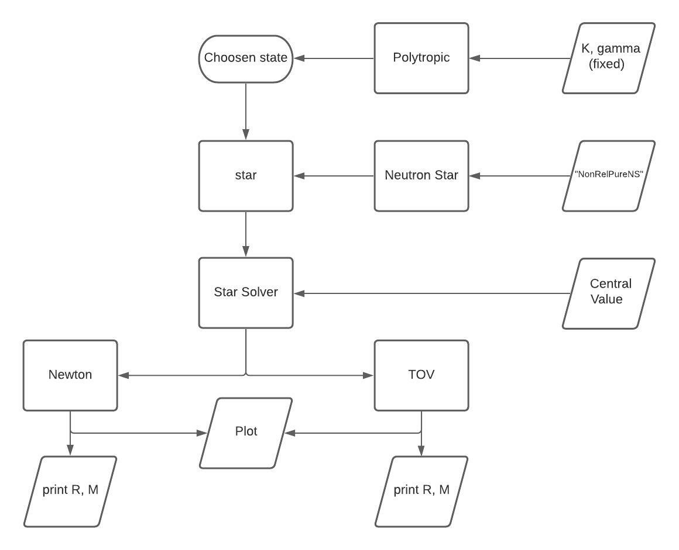
NON RELATIVISTIC PURE NEUTRON STAR MAIN
K, Gamma (fixed)
«NonRelPureNS»
Central Value

Slide 12
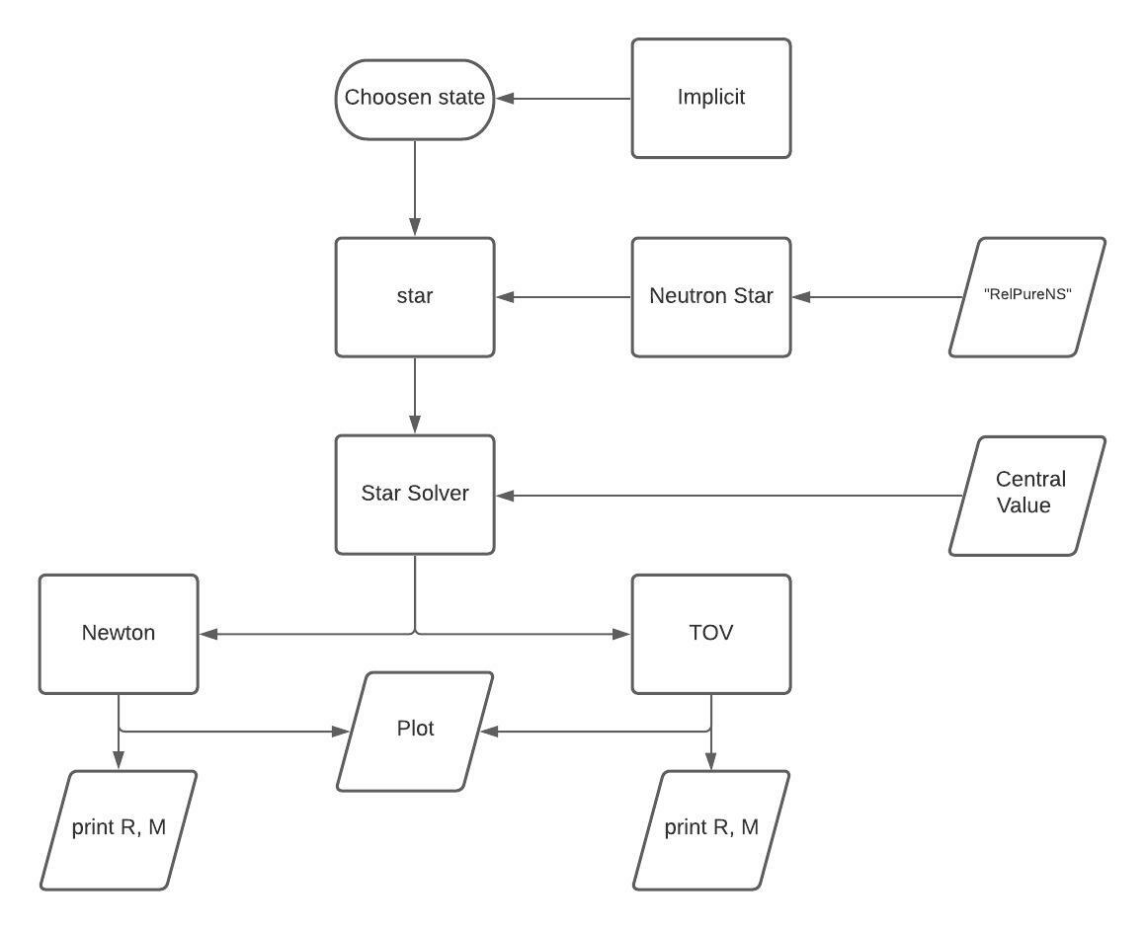
RELATIVISTIC PURE NEUTRON STAR MAIN
«RelPureNS»
Central value

Slide 13
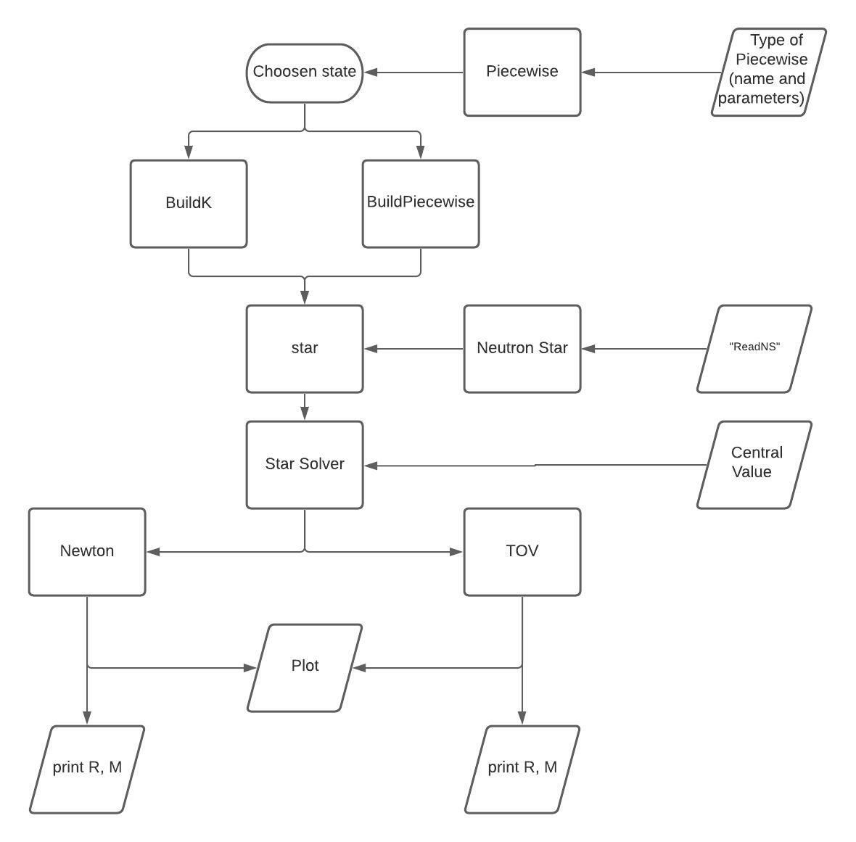
READ NON PURE NEUTRON STAR MAIN
Type of piecewise
«Read NS»
Central value

Slide 14
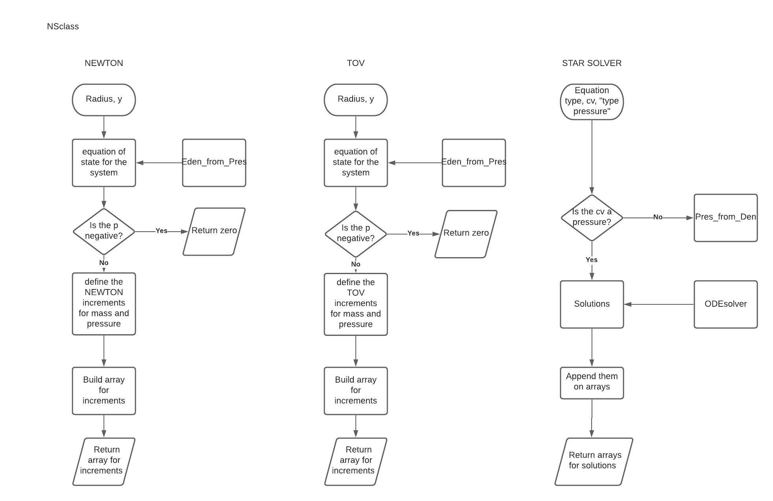
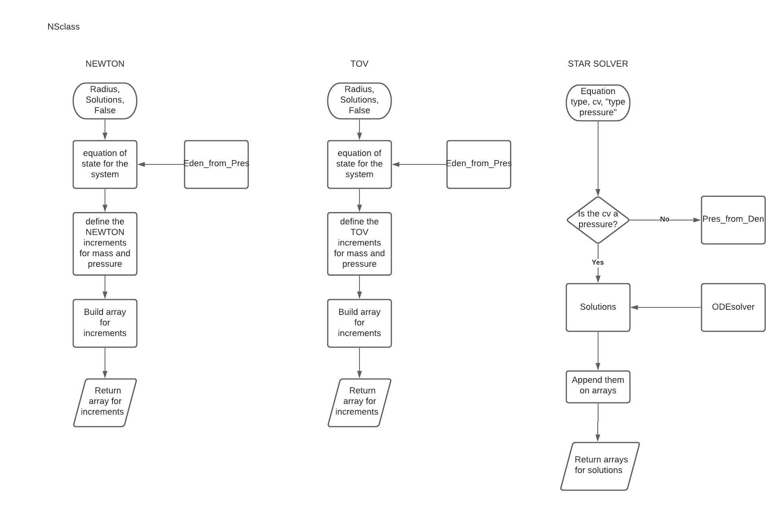
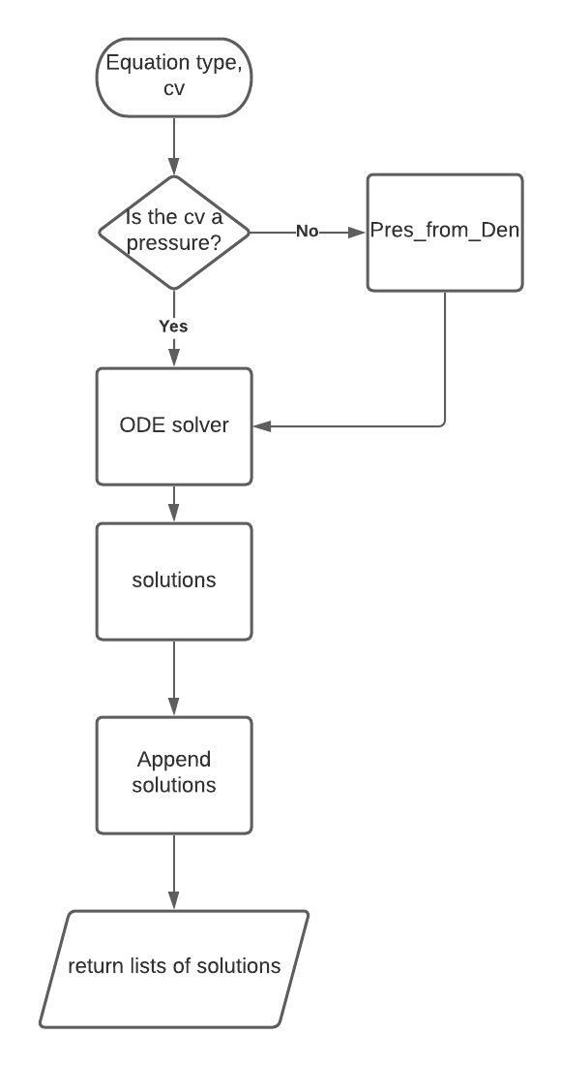
NS CLASS METHODS:
y
y

Slide 15
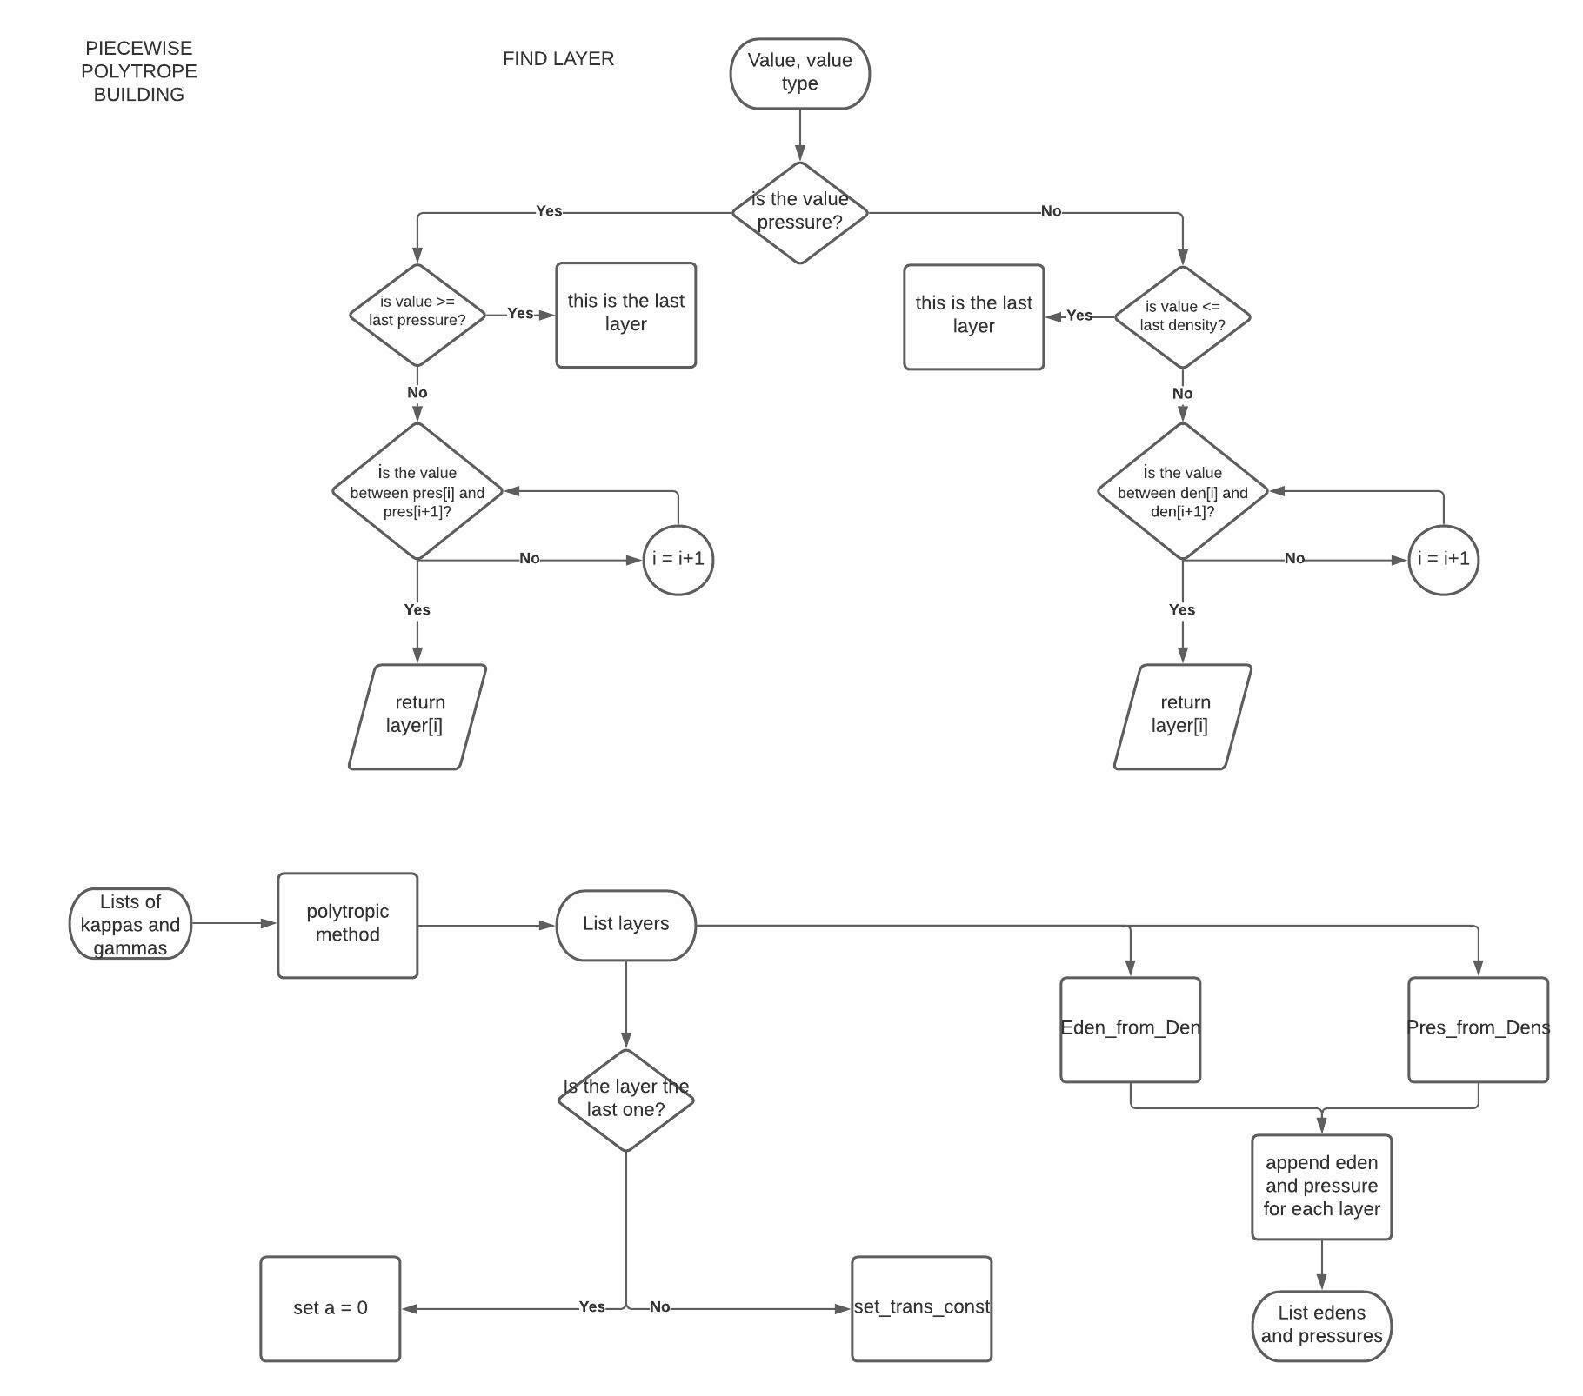
PIECEWISE POLYTROPE BUILDING
Return this layer
Return this layer
Polytropic class
Layer= Polytropic

Slide 16
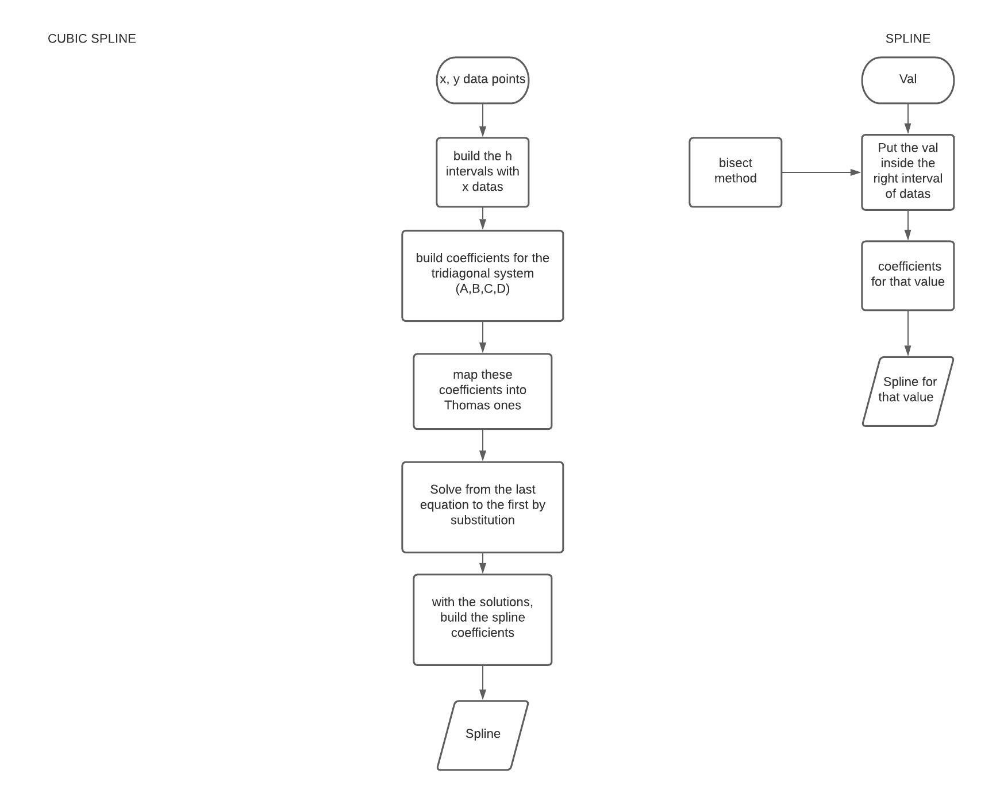
CUBIC SPLINE

Slide 17
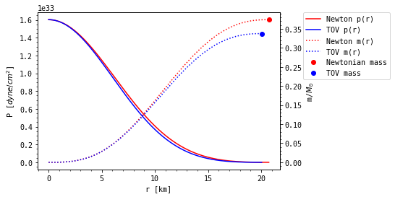
SOME RESULTS
Cv = 1.6*10°33

Slide 18
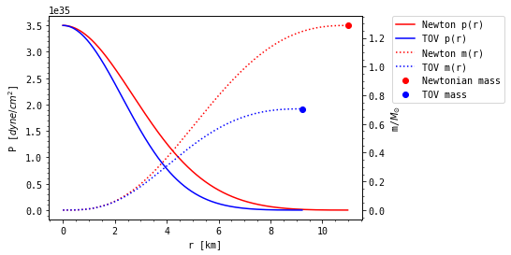
SOME RESULTS
Cv = 3.5*10°35

Slide 19
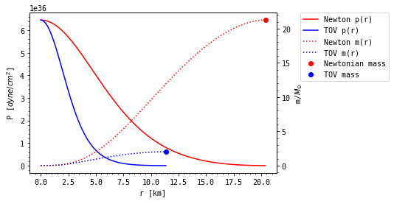
SOME RESULTS
PAL6 (neutrons, protons, electrons, muons)
Cv = 3.5*10°15

Slide 20
BIBLIOGRAPHY
"Neutron stars for undergraduates", R. R. Silbar, S. Reddy, 2004.
"Compact Stars for Undergraduates", I. Sagert et al, 2004.
"Constraints on a phenomenologically parametrized neutron-star equation of state", J. Read et al, 2009.
"On Massive Neutron Cores", J. Oppenheimer, 1939.
"Computational Physics, Lecture Notes Fall 2015", M. Jensen, 2015.
"Programming for Computations - A Gentle Introduction to Numerical Simulations with Python", S. Linge, H.Langtangen, 2016.
https://en.wikiversity.org/wiki/Cubic_Spline_Interpolation

Slide 21
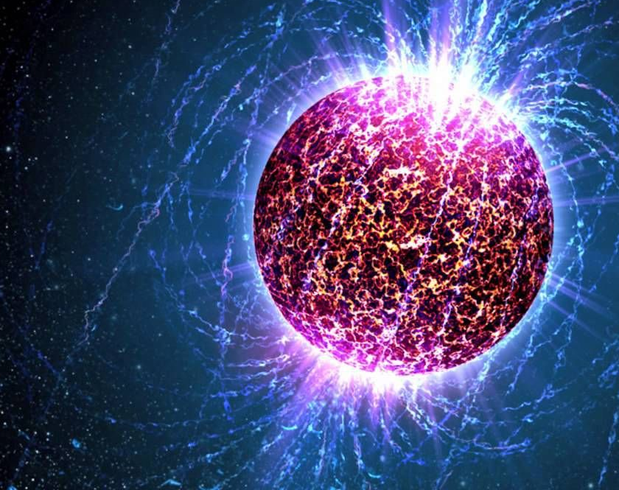
THANKS FOR YOUR ATTENTION

